Slide 1
ELECTRICAL SCIENCE-1 (15B11EC111) UNIT-1 Lecture-4

Slide 2
Topics to be Discussed
Sources
Independent sources
Ideal Sources
Dependent sources
Types of dependent sources
voltage-controlled voltage source (VCVS)
current-controlled voltage source (CCVS)
voltage-controlled current source (VCCS)
current-controlled current source (CCCS)
References

Slide 3
SOURCES
Sources -devices that are intended to supply energy to a circuit. A source is a voltage or current generator capable of supplying energy to a circuit. An active two-terminal element that supplies energy to a circuit is a source of energy.
Sources are categorized as : voltage sources and current sources.
Figure shows the symbol that is used to represent a voltage source and a current source
The voltage of a voltage source is specified but current is determined by the rest of the circuit. A voltage source is described by specifying the function v(t), for example, v(t) = 12 cos 1000t or v(t) = 9 or v(t) = 12-2t
The current of a current source is specified, but the voltage is determined by the rest of the circuit. A current source is described by specifying the function i(t), for example, i(t) = 6 sin 500t or i(t) = —0.25 or i(t) = t+8

Slide 4
INDEPENDENT SOURCES
Independent source: a voltage or current generator not dependent on other circuit variables.
Independent voltage source: provides a specified voltage independent of the current through it and is independent of any other circuit variable.
For example, a voltage source specified by v(t) = 9 volts will have a voltage of 9 volts regardless of the circuit in which it is used. In contrast, the current of the voltage source depends on the circuit in which the source is used. The current could be 6 amps when the voltage source is connected to one circuit and 6 milliamps when the voltage source is connected to another circuit.
Independent current source: provides a current independent of the voltage across the source element and is independent of any other circuit variable.
For example, a current source specified by i(t) = —0.25 milliamps will have a current of —0.25 milliamps in any circuit in which it is used. The voltage across this current source will depend on the particular circuit.

Slide 5
IDEAL SOURCES
The preceding slides have ignored some complexities to give a simple description of the way sources work.
The voltage across a 9-volt battery may not actually be 9 volts. This voltage depends on the age of the battery, the temperature, variations in manufacturing, and the battery current.
It is useful to make a distinction between real sources, such as batteries, and the simple voltage and current sources
The simple sources described in the previous paragraph are called the ideal voltage source and the ideal current source.
The voltage of an ideal voltage source is given to be a specified function, say v(t). The current is determined by the rest of the circuit.
The current of an ideal current source is given to be a specified function, say i(t). The voltage is determined by the rest of the circuit.
An ideal source is a voltage or a current generator independent of the current through the voltage source or the voltage across the current source.

Slide 6
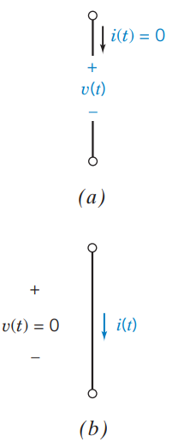
IDEAL SOURCES
The short circuit and open circuit are special cases of ideal sources. Figure shows the symbols used to represent the short circuit and the open circuit.
A short circuit is an ideal voltage source having v(t) = 0. The current in a short circuit is determined by the rest of the circuit.
An open circuit is an ideal current source having i(t) = 0. The voltage across an open circuit is determined by the rest of the circuit.
The power absorbed by each of these devices is zero.
Open and short circuits can be added to a circuit without disturbing the branch currents and voltages of all the other devices in the circuit.
Open circuits and short circuits can also be described as special cases of resistors. A resistor v(t) = 0 with resistance R = 0 (G =∞ ) is a short circuit. A resistor with conductance G = 0 (R = ∞ ) is an open circuit.
Fig. (a) Open Circuit
Fig. (b) Short Circuit

Slide 7
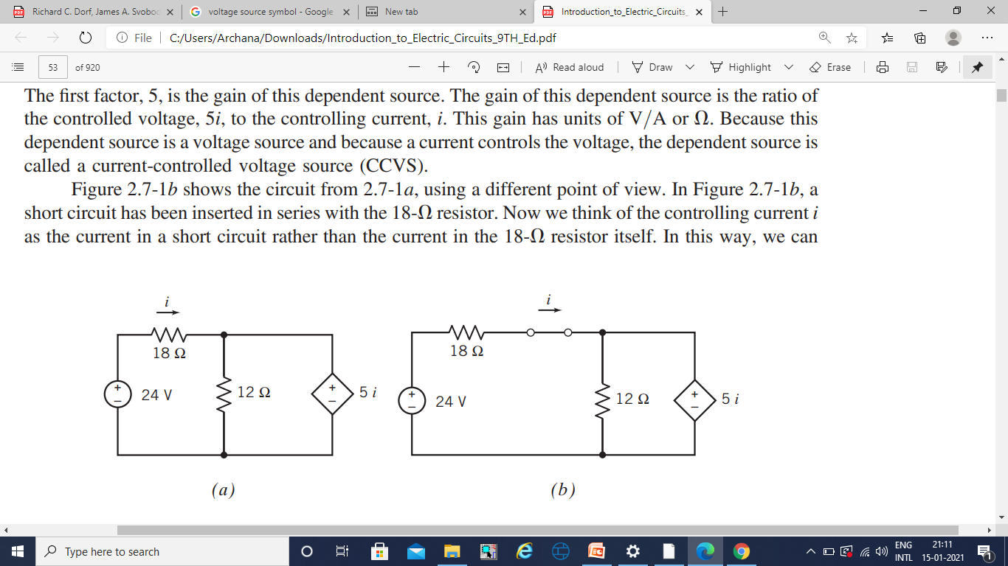
DEPENDENT SOURCES
Dependent sources model the situation in which the voltage or current of one circuit element is proportional to the voltage or current of the second circuit element.
(In contrast, a resistor is a circuit element in which the voltage of the element is proportional to the current in the same element.)
Dependent sources are used to model electronic devices such as transistors and amplifiers. For example, the output voltage of an amplifier is proportional to the input voltage of that amplifier, so an amplifier can be modeled as a dependent source.
Fig. (a) shows a circuit that includes a dependent source represented by the diamond symbol. The plus/minus signs identify the dependent source as a voltage source and indicate the reference polarity of the element voltage.

Slide 8
DEPENDENT SOURCES
The label “ 5i” represents the voltage of this dependent source.
Voltage of this dependent source is controlled by the current, i, in the 18Ω resistor.
The gain of this dependent source is 5 which is the ratio of the controlled voltage, 5i, to the controlling current, i. This gain has units of V/A or Ω.
Because this dependent source is a voltage source and because a current controls the voltage, the dependent source is called a current-controlled voltage source (CCVS)
Fig. (b) shows the circuit from fig. (a), using a different point of view.
A short circuit is inserted in series with the 18Ω resistor. The controlling current i can be thought of the current in a short circuit rather than the current in the resistor itself In this way, we can always treat the controlling current of a dependent source as the current in a short circuit. This is used to categorize dependent sources.

Slide 9
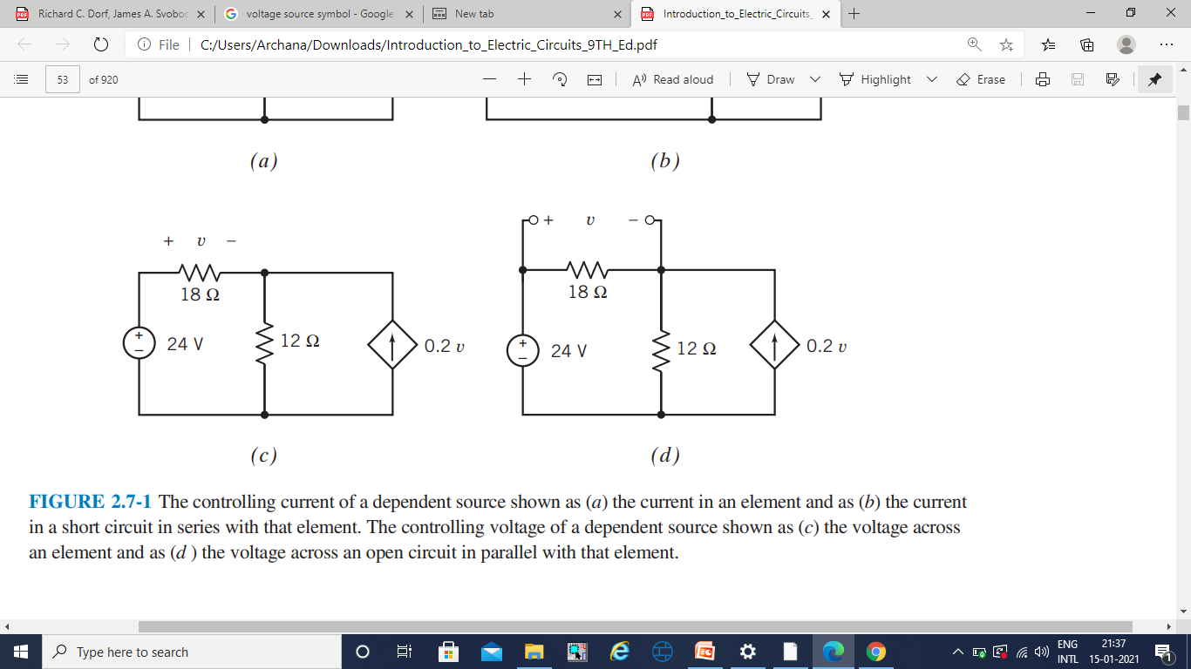
DEPENDENT SOURCES
Fig. (c) shows a circuit that includes a dependent source, represented by the diamond symbol. The arrow inside the diamond identifies the dependent source as a current source and indicates the reference direction of the element current.
The label “ 0.2v” represents the current of this dependent source.
The factor v, indicates that the current of this dependent source is controlled by the voltage, v, across the 18Ω resistor.
The gain of this dependent source is 0.2, which is the ratio of the controlled current, 0.2v, to the controlling voltage, v. This gain has units of A/V.
This dependent source is a current source and a voltage controls the current, so it is called a voltage-controlled current source (VCCS).
Fig. (c)

Slide 10
DEPENDENT SOURCES…
In Fig. (d), an open circuit has been added in parallel with the 18Ω resistor.
Now we think of the controlling voltage v as the voltage across an open circuit Figure 2.7-1, rather than the voltage across the 18Ω resistor itself.
In this way, we can always treat the controlling voltage of a dependent source as the voltage across an open circuit.

Slide 11
TYPES OF DEPENDENT SOURCES
Each dependent source consists of two parts:
controlling part
controlled part
The controlling part is either an open circuit or a short circuit.
The controlled part is either a voltage source or a current source.
There are four types of dependent source that correspond to the four ways of choosing a controlling part and a controlled part.
These four dependent sources are:
voltage-controlled voltage source (VCVS)
current-controlled voltage source (CCVS)
voltage-controlled current source (VCCS)
current-controlled current source (CCCS)

Slide 12
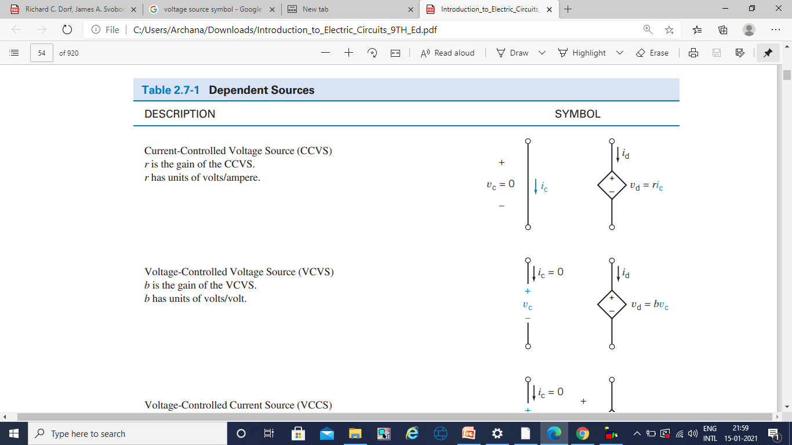
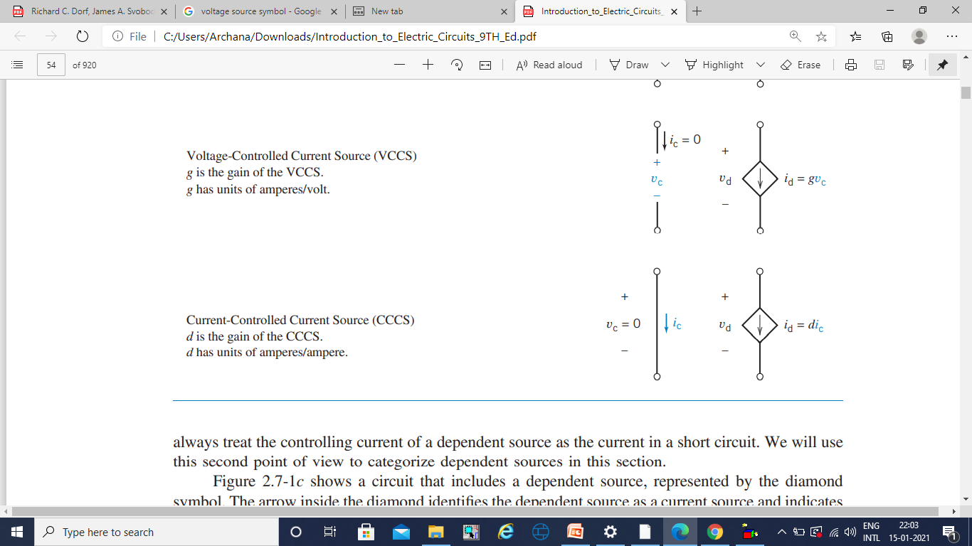
TYPES OF DEPENDENT SOURCES: SYMBOLS
1. Current-Controlled Voltage Source (CCVS)
r is the gain of the CCVS.
r has units of volts/ampere.
2. Voltage-Controlled Voltage Source (VCVS)
b is the gain of the VCVS.
b has units of volts/volt.
3. Voltage-Controlled Current Source (VCCS)
g is the gain of the VCCS.
g has units of amperes/volt.
4. Current-Controlled Current Source (CCCS)
d is the gain of the CCCS.
d has units of amperes/ampere.

Slide 13
TYPES OF DEPENDENT SOURCES…
CCVS:
The controlling element is a short circuit. The element current and voltage of the controlling element are denoted as i_{c} and v_{c}. The voltage across a short circuit is zero, so v_{c} = 0. The short-circuit current, i_{c}, is the controlling signal of this dependent source.
The controlled element is a voltage source. The element current and voltage of the controlled element are denoted as i_{d} and v_{d}. The voltage is controlled by i_{c,} v_{d} = r*i_{c}.
The constant r is called the gain of the CCVS. The current i_{d}, like the current in any voltage source is determined by the rest of the circuit.
VCVS:
The controlling element is an open circuit. The current in an open circuit is zero, so i_{c} = 0. The open-circuit voltage, v_{c} , is the controlling signal of this dependent source.
The controlled element is a voltage source. The voltage v_{d} is controlled by v_{c,} v_{d} = b* v_{c}
The constant b is called the gain of the VCVS. The current i_{d} is determined by the rest of the circuit.

Slide 14
TYPES OF DEPENDENT SOURCES…
VCCS:
The open-circuit voltage, v_{c}, is the controlling signal of this dependent source.
The controlled element is a current source.
The current i_{d} is controlled by v_{c} : i_{d} = g* v_{c.}
The constant g is called the gain of the VCCS. The voltage v_{c}, like the voltage across any current source, is determined by the rest of the circuit.
CCCS:
The controlling element of the CCCS shown in Table is a short circuit. The voltage across this open circuit is v_{c} = 0. The short-circuit current, i_{c}, is the controlling signal of this dependent source.
The controlled element is a current source.
The current i_{d} is controlled by v_{c} : i_{d} = g* v_{c}
The constant d is called the gain of the CCCS. The voltage v_{d}, like the voltage across any current source, is determined by the rest of the circuit.

Slide 15
REFERENCES
[1]R.C. Dorf and James A. Svoboda, “Introduction to Electric Circuits”, 9th ed, John Wiley & Sons, 2013.

